Slide 1


DATA VISUALIZATION ASSOCIATE INTERNSHIP PROJECT
FINAL PRESENTATION : 46B TEAM
MEMBERS:
HAMZA ANWAR
YASHWITHA REDDY
DHEERAJ DARA

Slide 2


📌 PROJECT OVERVIEW
INTERNSHIP OBJECTIVE:
ENGAGE WITH REAL-WORLD DATASETS TO EXTRACT KEY INSIGHTS.
APPLY DATA ANALYSIS AND VISUALIZATION TECHNIQUES.
PRESENT DATA-DRIVEN RECOMMENDATIONS EFFECTIVELY.
KEY SKILLS DEVELOPED:
DATA CLEANING & PREPROCESSING
EXPLORATORY DATA ANALYSIS (EDA)
CREATING EFFECTIVE VISUALIZATIONS
BUILDING DASHBOARDS & REPORTS
PROJECT PHASES:
1️⃣ WEEK 1: DATA EXPLORATION & CLEANING
2️⃣ WEEK 2: MERGING DATASETS & STRUCTURING TABLES
3️⃣ WEEK 3: DEVELOPING DASHBOARDS (LOOKER STUDIO)
4️⃣ WEEK 4: PRESENTATION OF INSIGHTS

Slide 3


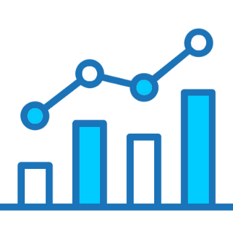
FINAL DELIVERABLES:
✅ CLEANED & TRANSFORMED DATASET
✅ INTERACTIVE DASHBOARD WITH KEY INSIGHTS
✅ FINAL REPORT & PRESENTATION

Slide 4



📌 INTERNSHIP STRUCTURE - TIMELINE OVERVIEW
📅 WEEK 1: DATA
🔹 EXPLORATION & CLEANING
🔹 UNDERSTAND AND EXPLORE DATASETS
🔹 CONDUCT EXPLORATORY DATA
ANALYSIS (EDA)
🔹 CLEAN AND PREPROCESS DATA FOR ACCURACY
📅 Week 2: Data Merging & Relationship Building
🔹 Merge multiple datasets
🔹 Define relationships (Primary & Foreign Keys)
🔹 Structure data for seamless analysis
📅 Week 3: Dashboard Development
in Looker Studio
🔹 Develop interactive data visualizations
🔹 Create dashboards highlighting key metrics and trends
🔹 Ensure clarity and effectiveness in reporting
📅 Week 4: Compilation of Findings & Final Presentation
🔹 Summarize insights and recommendations
🔹 Prepare the final report and dashboard
🔹 Present findings to senior management

Slide 5


📌 PROJECT SCOPE
OBJECTIVE:
To analyze REAL-WORLD DATASETS, EXTRACT MEANINGFUL INSIGHTS, AND PRESENT DATA-DRIVEN RECOMMENDATIONS THROUGH INTERACTIVE DASHBOARDS.
KEY FOCUS AREAS:
🔹 DATA COLLECTION & CLEANING – PROCESS RAW DATASETS TO ENSURE ACCURACY AND CONSISTENCY.
🔹 EXPLORATORY DATA ANALYSIS (EDA) – IDENTIFY TRENDS, PATTERNS, AND ANOMALIES.
🔹 DATA INTEGRATION & STRUCTURING – MERGE DATASETS AND ESTABLISH RELATIONSHIPS FOR SEAMLESS ANALYSIS.
🔹 DASHBOARD DEVELOPMENT – CREATE INTERACTIVE VISUALIZATIONS IN LOOKER STUDIO.
🔹 PRESENTATION & INSIGHTS SHARING – COMMUNICATE FINDINGS TO STAKEHOLDERS EFFECTIVELY.
✅ In-Scope:
✔ Working with structured datasets
✔ Performing EDA & data cleaning
✔ Developing dashboards with key insights
✔ Presenting actionable recommendations
❌ Out of Scope:
✖ Unstructured data analysis (e.g., text, image data)
✖ Advanced machine learning techniques
✖ Predictive modeling

Slide 6



🛠 TOOLS & TECHNOLOGIES USED
🔹 Data Cleaning & Processing
✔ Excel – Handling, transforming, and cleaning raw data using formulas and pivot tables.
✔ SQL – Querying databases, filtering data, and performing transformations.
🔹 Data Analysis
✔ Python (Pandas, NumPy) – Data manipulation, statistical analysis, and exploratory data analysis (EDA).
🔹 Data Visualization
✔ Looker Studio – Building interactive dashboards for insights and decision-making.
✔ Power BI – Creating dynamic reports and advanced visualizations.
🔹 Collaboration & Communication
✔ Microsoft Teams – Team discussions, meetings, and file sharing.
✔ Email – Official communication and progress updates.

Slide 7

📌 DATASETS OVERVIEW
6
Data
sets
1. LEARNER DATA (LEARNER_RAW(IN).CSV)
CONTAINS INFORMATION ABOUT LEARNERS, INCLUDING ID, COUNTRY, DEGREE, INSTITUTION, AND MAJOR.
2. OPPORTUNITY DATA (OPPORTUNITY_RAW(IN).CSV)
STORES INFORMATION ON DIFFERENT OPPORTUNITIES SUCH AS EVENTS, INTERNSHIPS, AND COMPETITIONS.
3. COHORT DATA
TRACKS COHORT ENROLLMENTS, INCLUDING START AND END DATES.
4. MARKETING DATA
INCLUDES METRICS LIKE REACH, CLICKS, CPC (COST PER CLICK), AND COST PER RESULT.
5. LEARNER OPPORTUNITY DATA
TRACKS WHICH LEARNERS APPLIED TO WHICH OPPORTUNITIES AND THEIR APPLICATION STATUS.
6. COGNITO DATA
STORES USER AUTHENTICATION DETAILS, INCLUDING EMAIL, GENDER, CITY, STATE, AND ZIP CODE.

Slide 8


I) USER DATA OVERVIEW
📌 DESCRIPTION: CONTAINS LEARNER INFORMATION SUCH AS ID, COUNTRY, DEGREE, INSTITUTION, AND MAJOR.
📊 DATASET STRUCTURE:
ROWS: 129,259
COLUMNS: 5
KEY FIELDS: LEARNER_ID, COUNTRY, DEGREE, INSTITUTION, MAJOR
🔍 KEY INSIGHTS:
NO DUPLICATE LEARNER_ID.
MOST LEARNERS FROM: 🇮🇳 INDIA (33,868 USERS)
MOST COMMON DEGREE: GRADUATE STUDENT (31,806 USERS)
MOST FREQUENT INSTITUTION: SAINT LOUIS UNIVERSITY (2,163 USERS)
⚠️ MISSING DATA & ISSUES:
DEGREE, INSTITUTION, AND MAJOR HAVE MISSING VALUES.
✅ NEXT STEPS:
HANDLE MISSING VALUES.
STANDARDIZE INSTITUTION NAMES.
📈 VISUALS:
A BAR CHART SHOWING COUNTRY-WISE LEARNER DISTRIBUTION.
A PIE CHART FOR THE DEGREE DISTRIBUTION.

Slide 9
II) OPPORTUNITY DATA (OPPORTUNITY_RAW(IN).CSV)
📌 DESCRIPTION:
STORES INFORMATION ON DIFFERENT OPPORTUNITIES (EVENTS, INTERNSHIPS, COMPETITIONS).
📊 DATASET STRUCTURE:
ROWS: 187
COLUMNS: 5
KEY FIELDS: OPPORTUNITY_ID, OPPORTUNITY_NAME, CATEGORY, OPPORTUNITY_CODE, TRACKING_QUESTIONS
🔍 KEY INSIGHTS:
MOST COMMON CATEGORIES: INTERNSHIP (43), EVENT (41), COMPETITION (41)
MISSING DATA: TRACKING_QUESTIONS HAS 69 MISSING VALUES.
⚠️ DATA CLEANING NEEDED:
STANDARDIZING OPPORTUNITY_CODE.
✅ NEXT STEPS:
FILL MISSING TRACKING_QUESTIONS VALUES.
ENSURE CATEGORY CONSISTENCY.
📈 VISUALS:
BAR CHART: NUMBER OF OPPORTUNITIES BY CATEGORY.
TABLE: SAMPLE OF TOP 5 OPPORTUNITIES.

Slide 10

III) COHORT DATA OVERVIEW
📌 DESCRIPTION:
TRACKS COHORT ENROLLMENTS, INCLUDING START AND END DATES.
📊 DATASET STRUCTURE:
ROWS: 639
COLUMNS: 5
🔍 KEY INSIGHTS:
STRONG CORRELATION (R=0.94) BETWEEN START_DATE & END_DATE.
NO MISSING VALUES OR DUPLICATES.
⚠️ OUTLIERS FOUND:
SIZE COLUMN HAS EXTREME VALUES.
✅ NEXT STEPS:
REMOVE OR ADJUST OUTLIERS.
FURTHER ANALYZE CORRELATIONS.
📈 VISUALS:
SCATTER PLOT: CORRELATION BETWEEN START AND END DATES.
BOX PLOT: OUTLIERS IN THE SIZE COLUMN.

Slide 11
IV) MARKETING DATA OVERVIEW
📌 DESCRIPTION:
INCLUDES REACH, CLICKS, CPC, AND COST PER RESULT.
📊 DATASET STRUCTURE:
ROWS: 141
COLUMNS: 14
🔍 KEY INSIGHTS:
AVERAGE REACH: 1,702,851
AMOUNT SPENT: MIN: 0.99, MAX: 25,531.47, MEAN: 2,399.96 AED
⚠️ MISSING DATA:
OUTBOUND CLICKS (2), LANDING PAGE VIEWS (2), CPC (1).
✅ NEXT STEPS:
FILL MISSING VALUES.
IDENTIFY COST-RELATED OUTLIERS.
📈 VISUALS:
HISTOGRAM FOR AMOUNT SPENT.
LINE CHART FOR CPC TRENDS.

Slide 12
V) LEARNER OPPORTUNITY DATA
📌 DESCRIPTION:
TRACKS LEARNER ENROLLMENTS AND APPLICATIONS.
📊 DATASET STRUCTURE:
KEY COLUMNS: LEARNER_ID, APPLY_DATE, OPPORTUNITY_CODE, STATUS
🔍 KEY INSIGHTS:
COMMON STATUSES: SUBMITTED, APPROVED, REJECTED.
TOP 5 APPLIED OPPORTUNITIES IDENTIFIED.
✅ NEXT STEPS:
CLEAN MISSING VALUES.
ANALYZE APPLICATION TRENDS.
📈 VISUALS:
PIE CHART OF APPLICATION STATUSES.
TABLE WITH THE MOST APPLIED OPPORTUNITIES.

Slide 13
VI) COGNITO DATA
📌 DESCRIPTION:
USER AUTHENTICATION AND METADATA.
📊 DATASET STRUCTURE:
KEY FIELDS: USER_ID, EMAIL, GENDER, CITY, ZIP, STATE
🔍 KEY INSIGHTS:
TOTAL USERS ANALYZED.
USER SIGNUPS TRACKED OVER TIME.
✅ NEXT STEPS:
STANDARDIZE EMAIL FORMATS.
FIX DATE INCONSISTENCIES.
📈 VISUALS:
BAR CHART FOR GENDER DISTRIBUTION.
TIMELINE CHART FOR USER SIGNUPS.

Slide 14

EVALUATION PROCESS
• ANALYZED DATASET STRUCTURE
• IDENTIFIED MISSING VALUES & DUPLICATES
• DETECTED INCONSISTENCIES IN DATA TYPES
• GENERATED SUMMARY STATISTICS FOR KEY ATTRIBUTES

Slide 15
PYTHON IN DATA QUALITY
Create data frame by Pandas and load data from CSB
pd.read_csb()
Find columns and rows
df.shape
Making summary
df.describe()
Check Missing and Duplicate values
df.isnull().sum()
df.duplicated().sum()
Outlier detection (Identify and handle unusual data points on important column)
Heatmap Generation
sns.heatmap(correlation_matrix, annot=True, cmap='coolwarm', fmt=".2f")
Visualization : Histograms and Boxplot
sns.histplot(df["size"], bins=30)
sns.boxplot(x=df["size"])

Slide 16
POSTGRESQL IN DATA QUALITY
Create Table
CREATE TABLE name ( col1 VARCHAR(255), col2 .....);
Load Data
COPY name FROM 'location\name.csv' DELIMITER ',' CSV HEADER;
Check Missing and Duplicate values
SELECT column_name, COUNT(*) - COUNT(column_name) AS missing_count FROM name GROUP BY column_name;
SELECT column_name, COUNT(*) FROM name GROUP BY col_id HAVING COUNT(*)> 1;
Handle null timestarp
UPDATE name SET date = NULL WHERE date = 'unknown' OR date = '';
Visualization: Pie Chart & Line Chart
SELECT col ,COUNT(*) AS user FROM name GROUP BY col2 ORDER BY user DESC;
SELECT col, COUNT(*) * 100.0/ SUM(COUNT(*)) OVER()AS percentage FROM col GROUP BY column ORDER BY percentage DESC;

Slide 17
ETL PROCESS
Identified data quality issues.
Applied cleaning transformations.
Designed & implemented Master Table.
Conducted validation & quality checks.

Slide 18
DATA QUALITY ISSUES & CLEANUP
Duplicate Emails: 150
Inconsistent Text Formats: 320
Missing Email Values: 20
Invalid Phone Numbers: 45
Empty Addresses: 78
Duplicate Removal: Kept first occurrence.
Text Standardization: Converted to lowercase & trimmed spaces.
Null Handling (Email): Removed NULL email records.
Phone Number Validation: Removed invalid formats.
Address Cleaning: Replaced NULL with 'Not Provided'.

Slide 19
CREATE & LOAD MASTER TABLE
Create Master Table
CREATE TABLE master_table (id SERIAL PRIMARY KEY, learner_id VARCHAR(50), country VARCHAR(100), degree VARCHAR(100), institution VARCHAR(255), major VARCHAR(255), email VARCHAR(255), gender VARCHAR(20), UserCreateDate TIMESTAMP, apply_date TIMESTAMP, status VARCHAR(50), cohort_id VARCHAR(50));
Load Master Table
COPY master_table FROM 'path/to/your/file.csv'WITH (FORMAT CSV, HEADER TRUE, NULL '');
SQl validation Query
SELECT COUNT(*) FROM Final_Master_Table WHERE email IS NULL;

Slide 20
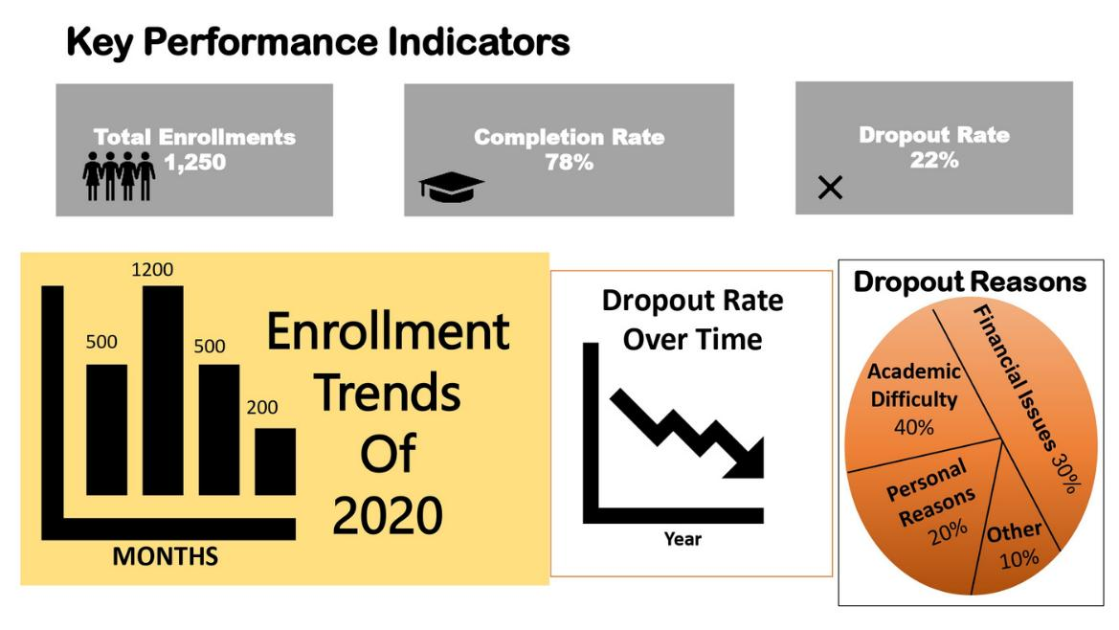
DASHBOARD (WIREFRAME)
Placement of KPIs, trends, filters, and graphs.

Slide 21
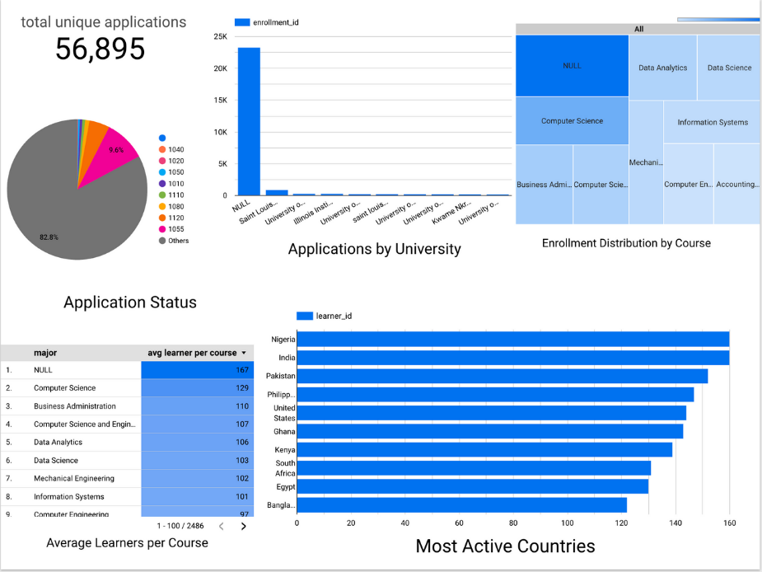
DASHBOARD (LOOKER STUDIO)
Visualization Tools Used: Looker Studio
Key Features: Interactive graphs, filters,
KPIs, and drill-down options.
Purpose: Provides quick, data-driven
insights.

Slide 22

DASHBOARD (LOOKER STUDIO)
1️⃣ Total Unique Applications: 56,895
Observation: Large number of applications; 82.8% categorized as "Others."
Business Impact: Indicates high diversity in applicants, requiring better segmentation.
2️⃣ Enrollment Distribution by Course
Observation: Data Analytics, Data Science, and Computer Science are top courses.
Business Impact: Highlights demand for tech-focused courses, useful for course planning.

Slide 23
DASHBOARD (LOOKER STUDIO)
3️⃣ Application Status & Average Learners per Course
Observation: Highest learners per course are from "NULL" (unclassified category).
Business Impact: Need to improve data categorization to gain clearer insights.
4️⃣ Most Active Countries
Observation: Nigeria, India, and Pakistan have the highest engagement.
Business Impact: Helps in targeted marketing and regional course offerings.

Slide 24
CONCLUSION
This project has successfully demonstrated how effective data analytics can drive strategic decision-making. By integrating multiple datasets, leveraging statistical analysis, and developing interactive dashboards, we were able to generate meaningful insights that support business growth. The structured approach allowed for seamless data transformation, visualization, and storytelling, ensuring stakeholders could make informed decisions. Moving forward, further enhancements, such as predictive modeling, could be explored to enhance forecasting capabilities.

Slide 25

WE WANT TO SAY
THANK YOU
FOR YOUR ATTENTION

